Slide 1
SCHOOL OF PHYSICS
Safety Induction
Updated June 2016

Slide 2
INTRODUCTION
Have you completed the UWA online Safety Induction?
Have you completed the Biosafety Induction?
Safety is everyone’s responsibility;
Be safe
Report anything unsafe

Slide 3
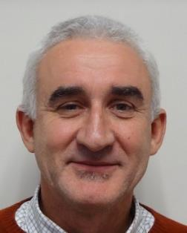
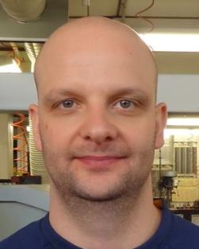
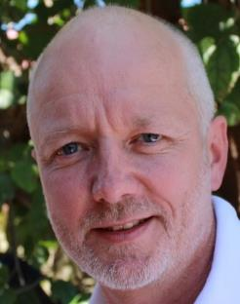
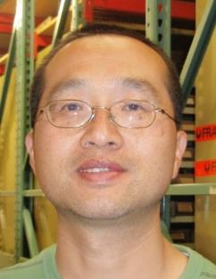
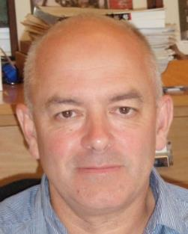
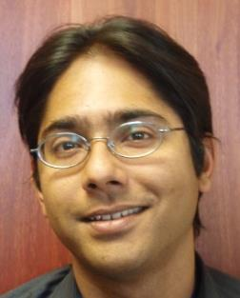
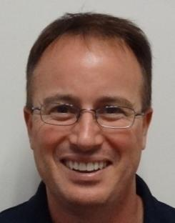
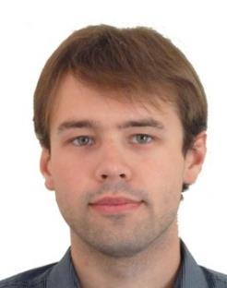
SCHOOL OF PHYSICS
WORK, HEALTH & SAFETY COMMITTEE
John Moore
Safety Committee Chair
School Safety Officer
Chemical Safety Officer
Building Warden
Markus Frankenberger
Safety and Health Representative
(Crawley & Gingin)
Tim St. Pierre
Biological Safety Officer
Ju Li
Laser Safety Officer
(Crawley)
Chunnong Zhao
Laser Safety Officer
(Gingin)
Ian McArthur
Head of School
Jay Jay Jegathesan
School Manager
Grant Walker
Industry Safety Representative
Renu Sharma
ICRAR
Nikita Kostylev
Student Representative

Slide 4
SCHOOL SAFETY MANUAL
Available online: http://www.physics.uwa.edu.au/staff/safety
Summarises majority of UWA Occupational Safety and Health rules and regulations
Outlines the majority of occupational health and safety issues in the school
Provides information on what to do in an emergency
Should be read by:
All staff
All Students including independent students*
* Independent students are those who are expected to operate without direct supervision

Slide 5
IN AN EMERGENCY
In case of an Emergency:
Dial 000
where an Ambulance or the Police is needed
Dial 2222 (6488 2222)
for UWA Security

Slide 6
INCIDENT, INJURY / NEAR MISS & HAZARD FORMS
Forms available online: http://www.safety.uwa.edu.au/incidents-injuries-emergency/notification
Incident, Injury / Near Miss Form:
When someone gets hurt or equipment is damaged
Also in case of a near miss
Hazard Report Form
Report potential for injury or damage

Slide 7
BUILDING EVACUATION
Always evacuate when the alarm sounds
Even if it is a test evacuation
Leave behind ALL belongings and exit immediately via the emergency stairs, do NOT attempt to use the elevators
There are multiple egress routes
Follow ALL directions from Area Wardens
This is the person with the red hat
Move away from the building
To your nearest Emergency Assembly Point

Slide 8
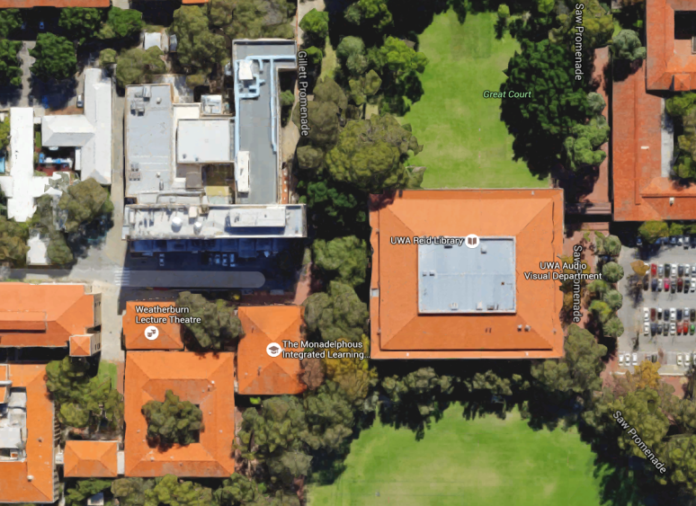
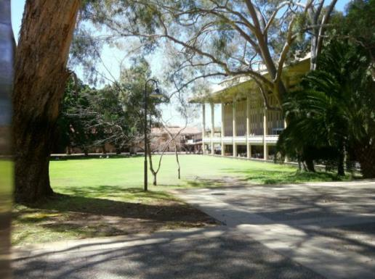
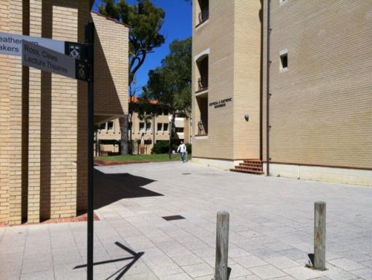
EMERGENCY ASSEMBLY POINTS
PHYSICS
Reid Library Lawn
Emergency Assembly Points:
Great Court Lawn in front of the Reid Library Between the Weatherburn Lecture Theatre & Electrical Engineering
Weatherburn LT & Electrical Engineering

Slide 9
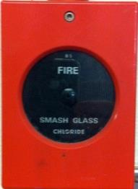
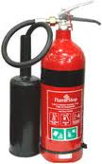
FIRE SAFETY
Do not attempt to fight a fire unless you feel it is safe to do so
Hit manual fire alarm if needed
Fire extinguishers:
Be aware of their placement and type
Use only if you are confident in their use

Slide 10
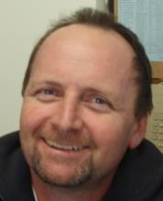
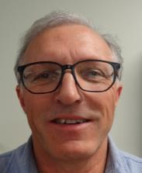
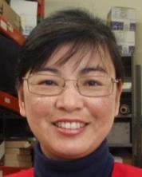
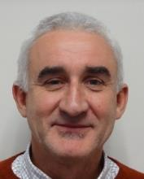
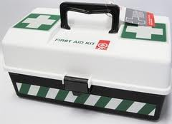
FIRST AID
Qualified First Aid Officers
First aid Room: ▪ B 11 (near lifts in basement)
First Aid Kits: ▪ Workshop B10B
First Year Labs 1.18
4th Floor Office 4.03
Defibrillator: ▪ Physics Atrium (Foyer), Ground Floor
John Moore
- Room B06 -
Dave McPhee
- Room B01 -
Joe Coletti
- Room 1.18 -
Ruby Chan
- Room 4.08 -

Slide 11
SECURITY
Physics Building open between 7:00am and 6:00pm on weekdays – see main office for afterhours access
Ensure all external doors are locked when you leave outside of these times
Ensure your office doors are locked when you are away (personal effects are not insured)
Keep your Staff/Student card on you at all times
If you have any safety concerns contact security on 3020 (6488 3020 from a mobile)

Slide 12
LABORATORY SAFETY HAZARDS
Physics Laboratory’s have a range of safety hazards:
If working in a lab you should be aware of them and read the relevant parts of the school safety manual and how to minimise risks
If you don’t know… ask!
CRYOGENS
FLAMMABLE
LASER
BIOLOGICAL
CHEMICAL
ELECTRICAL
MAGNETIC FIELD
RADIATION

Slide 13
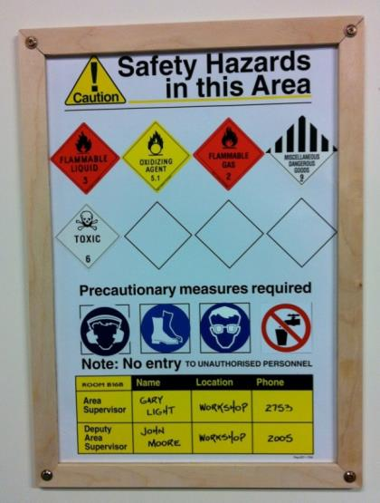
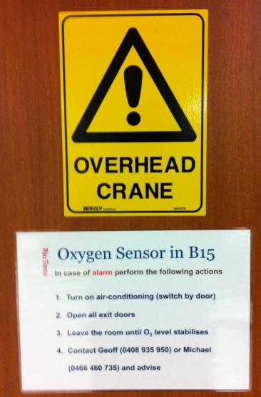
SIGNAGE
All labs have safety hazard signage near the entry, they may also have additional signs
These signs must always be acknowledged and obeyed

Slide 14
CHEMICAL SAFETY
Chemalert
Chemical Inventory and safety system
Read Safety Data Sheets (SDS)
Follow PPE and other instructions
Labeling
Label all containers with relevant information such as chemical type, safety risk, user name and date
Disposal
Make use of appropriate disposal methods
Spills
Only use appropriate clean up kits

Slide 15
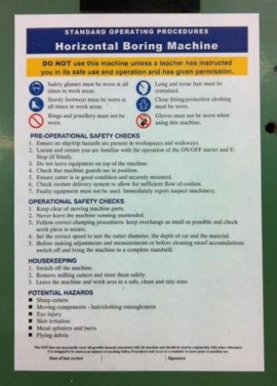
EQUIPMENT USE AND TRAINING
Do not use equipment unless trained to do so
Always get training first
Read Operating Procedure
Check instrument is safe to use
Report any safety issues
Consider reading manual

Slide 16
PERSONAL PROTECTIVE EQUIPMENT (PPE)
Fully enclosed shoes must be worn at ALL time in ALL laboratory’s
Use PPE if required
Gloves, safety glasses, aprons etc.
If not available contact laboratory supervisor
Do not think it’ll be fine

Slide 17
SAFETY TRAINING
Variety of safety training available at UWA:
Some are compulsory dependent on function
e.g. Unsealed radioisotopes, Laser safety course
Supervisors please identify the training required
Others Voluntary
e.g. manual handling, fire awareness
Full list available online at
http://www.safety.uwa.edu.au/induction-and-training/courses

Slide 18
LOCAL AREA – WALK AROUND
Supervisors please cover the following areas by showing personnel around your immediate work area:
Local safety hazards
Equipment which is potentially hazardous
Procedures to control risks within research group / area
Egress routes in case of an emergency
Location of PPE
Location of nearest first aid kit
Location of fire extinguishers
SCHOOL SAFETY INDUCTION ENDS ONCE LOCAL AREA WALK AROUND
IS COMPLETE AND ONE PAGE CONFIRMATION IS SIGNED OFF

